Slide 1
Digital Watermarking and Steganography - Mini Project SoSe 2019
Group 11: Sarah Böning, Anh Phoung Lee, Kai Gerrit Lünsdorf

Slide 2
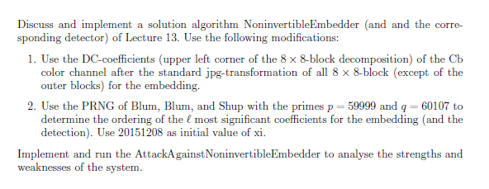
The Exercise

Slide 3
Our Interpretation
Implement 3 algorithms: Embedder, Attacker, Detector
Embedder: follow the given algorithm, but embed watermark on a random path (generated by BBS) of the upper left corner DCT coefficients of the Cb-colour channel
Detector: Takes watermarked & original image and computes the similarity
Attacker: tries to embed his own watermark
Analysis of the Watermarking System
Rightful Ownership Problem (Multiple public watermarked images)
others???
Python 3.7

Slide 4
Implementation - Embedder
Pseudocode of our own implementation
Some explanations maybe

Slide 5
Implementation - Detector

Slide 6
Implementation - Attacker

Slide 7
Analysis
What do we want to find out
Maybe some expectations

Slide 8
Analysis - Procedure
Take several photos with different features
Run the 3 algorithms
Vary: original images c, length of watermark
Statistical tests
χ ² test, number analysis, robustness, fidelity, histograms

Slide 9
Analysis - The Photo Set
Sets with different features for a differentiable evaluation
High contrast
Low contrast
Black and white
Highly textured
Monochrome
„Normal“ pictures / amateur photography
5 in each set (30 in total)

Slide 10





High Contrast

Slide 11



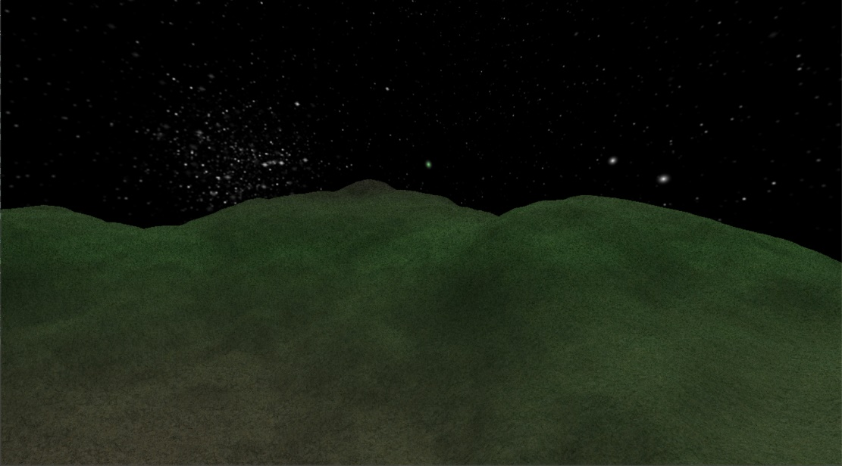
Low contrast

Slide 12





Black and White

Slide 13



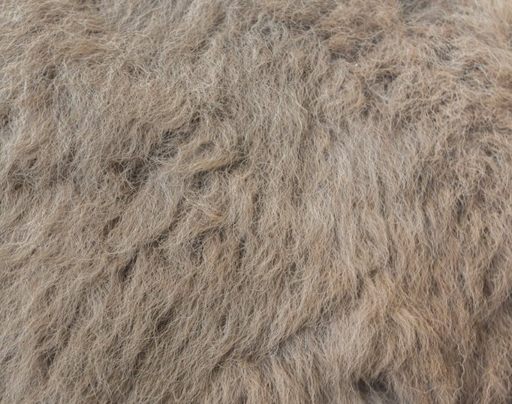
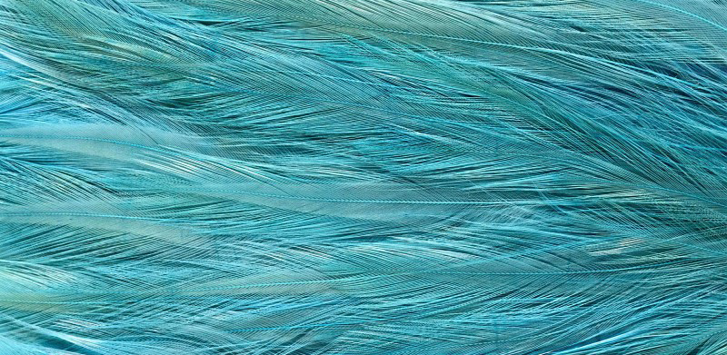
Highly Textured

Slide 14



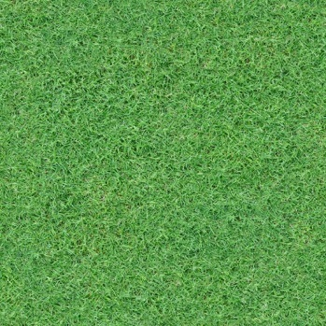

Monochrome

Slide 15
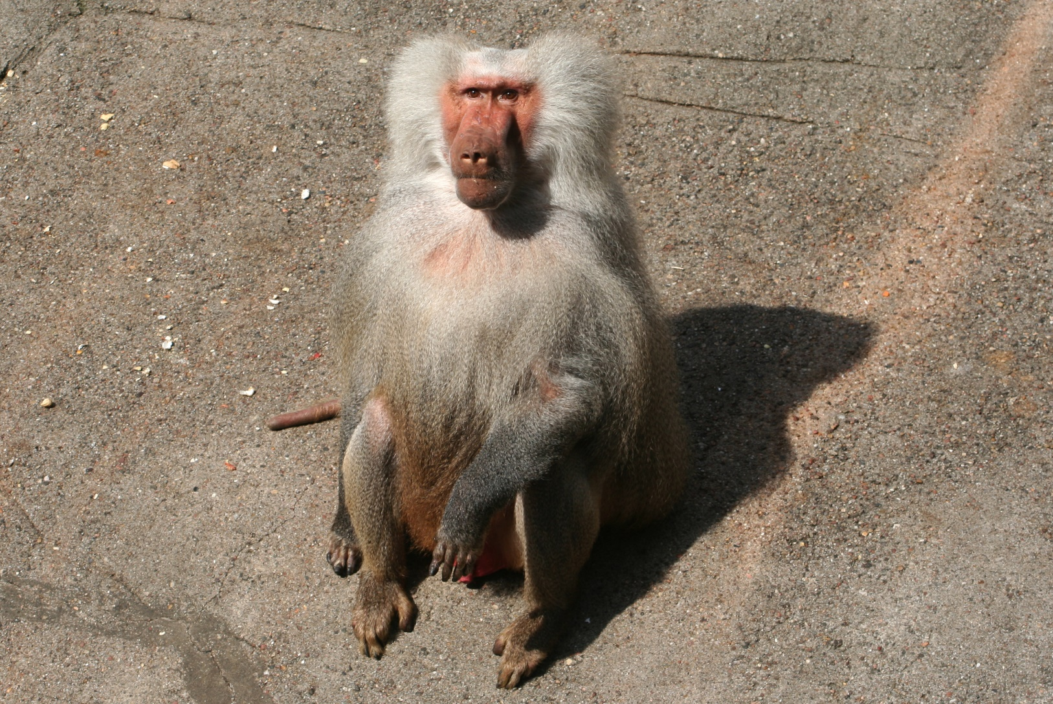
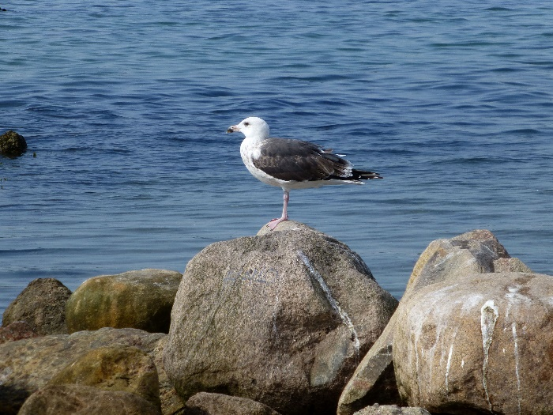
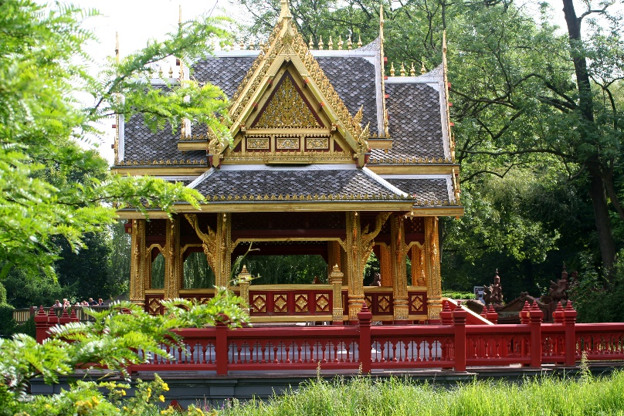
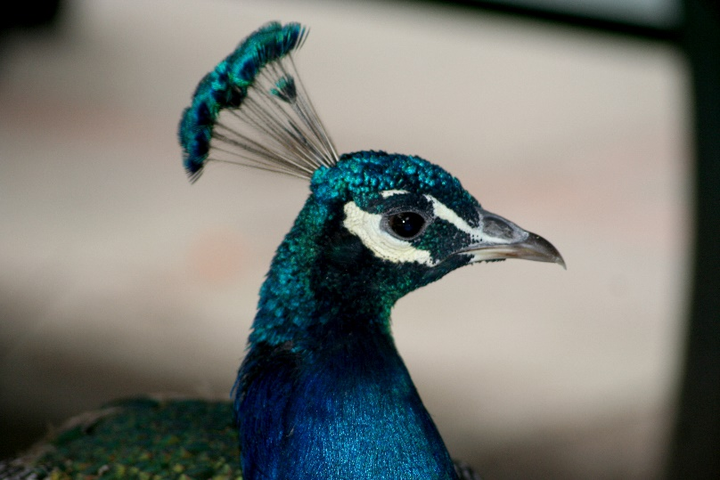

Amateur photography

Slide 16
Analysis – Number Analysis
Averages, majorities, means, no of changed pixels, differences in coeffs/pixels/images etc.

Slide 17
Analysis - χ² Test

Slide 18
Analysis - Histograms

Slide 19
Analysis - Fidelity

Slide 20
Analysis - Robustness

Slide 21
Analysis – Watermark Lengths

Slide 22
Analysis Summary & Conclusion
Is it safe against the Rightful Ownership Problem & the Attacker with multiple public images?
Is is safe in general/ against other attacks?
Strenghts and weaknesses of our wm system
How good are our results/limitations
Etc.

Slide 23

Any questions?
Thank you for your attention.

Slide 24
References
Lecture notes „Digital Watermarking and Steganography SoSe 2019“, Andreas Jakoby, Bauhaus University Weimar
Craver, Scott & Memon, Nasir & Yeo, Boon-Lock & Yeung, Minerva. (1997). On The Invertibility Of Invisible Watermarking Techniques. 1. 540 - 543 vol.1. 10.1109/ICIP.1997.647969.
Code: Python 3.6, Numpy 1.16, matplotlib 3
Images: private, textures.com, rawpixel.com, newevolutionsdesign.com, desktopimages.org, wikipedia

